Slide 1
Essay & Report Writing
Notes:
Introduce self
Introduce LD services

Slide 2
Learning Objectives
By the end of this session you will:
LO1: Understand differences between reports and essays.
LO2: Have explored essay structure in more detail.
LO3: Have considered how the above is relevant for your assignment.
Notes:
Run through
Explain that I’ve been invited to run this session to help with core essay/report writing skills which will help more generally but also align with the assignment for this module (LaTeX report on a topic related to study)

Slide 3
Your graduate development and employability assignment
Research and critically analyse a topic, presenting your own conclusions.
Your report should be approximately 2,000 in length.
Your report should consist of the following elements:
Title
Abstract
Introduction
Main body, which will have headings appropriate to your chosen topic
Discussion and conclusion
List of references
At least three citations to valid sources.
Notes:
For reference, this is some info on that assignment – for content and subject specific info, ask your unit leader (Daria). You will have other sessions supporting this assessment.
Title (in bold): conduct some research into the topic (you’ve been given a list of ten, including the use of mathematics in sport, prime numbers and diversity in mathematics.
The assignment brief gives you a length (three pages) and also specified some things the report should include (see list), including specific sections and features.
This session is going to focus on how to structure this assignment, based upon the brief, the template and Daria’s example. One thing to be aware of, is that this structure will differ slightly from a traditional scientific report. In fact, it is more like a traditional essay. You need to know the differences between the two, especially as it’s likely you’ll have to do both throughout your degree. It makes sense, then, to begin with an exploration of the types, their structure and any similarities or differences between then.
[Could ask for a show of hands who has done either before?]

Slide 4
Essays vs. Reports
Decide which of the following statements applies to essays, reports or both.
STRUCTURE
Structured using headings
Uses appendices
Section of recommendations
Combines data and analysis into single paragraphs
Features an abstract
Commonly features a methodology
Introduction and conclusion
FEATURES
Regularly features graphics
Separates results/findings and analysis
Evidence-based
FOCUS
Often heavily focuses on analysing or evaluating theories and past research
Usually presents data and findings that you have collected yourself.
Notes:
So let’s start to explore the similarities and differences between the two writing types. On the slide, there are some elements included in one or both of the types. Take some time to read through these and decide if you think they will feature in essays, in reports, or in both.
[5 minutes]

Slide 5
Essays vs Reports
Essays
Reports
STRUCTURE
Combines data and analysis into single paragraphs
Introduction and conclusion
FEATURES
Evidence-based
FOCUS
Often heavily focuses on analysing or evaluating theories and past research
STRUCTURE
Structured using headings
Uses appendices
Section of recommendations
Features an abstract
Commonly features a methodology
Introduction and conclusion
FEATURES
Regularly features graphics
Separates results/findings & analysis
Evidence-based
FOCUS
Usually presents data and findings that you have collected yourself.
Notes:
Run through the features of each (those highlighted in blue occur in both!).
Expansions:
ESSAYS
Combining data and analysis – so they are synthesised rather, we see data and then analysis straight away – they are not separated
Evidence based – i.e. using examples, statistics, readings to inform our arguments
Analyse and evaluate – focus on criticality not just description Past research and theory – so often more focused on what has come before and relevant argument (not research per se)
REPORTS
Headings – will usually align with structure (see next slide)
Recommendations – purpose is to research and advise (not just research and develop argument)
Methodology – data driven so needs methods
Presentation of experimental data (not just argument/theory)
So the template and brief here align more to an essay-style. You’re researching and arguing on a topic, not doing a study. Other assignments within your degree will be more report-based – i.e. experiments and conducting studies, exploring data and results
NOTE: You will need an abstract for your assignment even though it is more essay-based! We will come back to this at the end!
As you can see on the slides, the main differences are largely structural (e.g. what we include in each type of writing), so it makes sense from here to focus on the structure of the essay, to allow you to understand what is expected of this (and other) essay-based assignments

Slide 6
Report Structure
Essay Structure
Title
Title
Abstract
Introduction
Introduction
IMRAD
Section 1
Methods
Main Body
Section 2
Results
Section 3
Discussion
Conclusion
Conclusion
References
References
Appendices
Notes:
REPORTS
Ask if anyone has heard of IMRaD
Explain broad structure
Essays
Stress difference is in combining of data, argument and analysis
Has sections on topics instead of by element of research
Let’s explore that structure further…

Slide 7
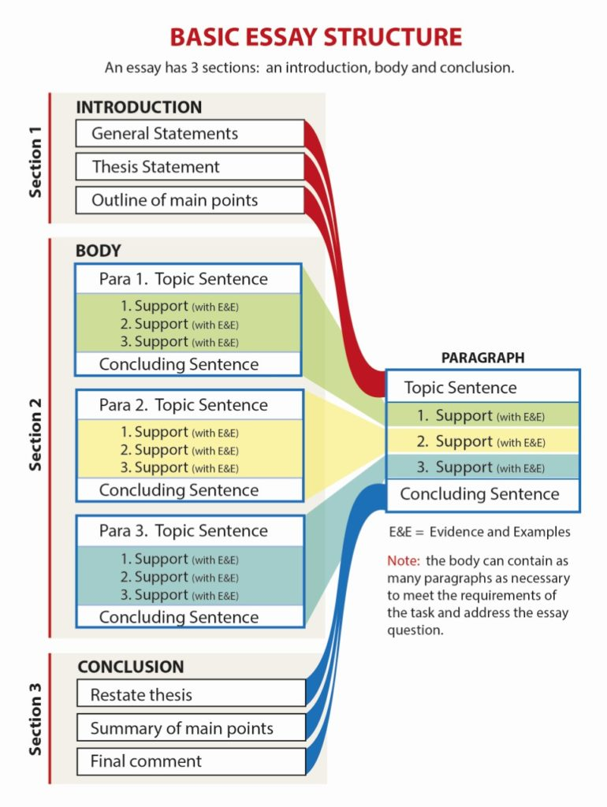
Notes:
THREE SECTIONS:
Introduction
Main body
Conclusion
Introduction – general statements and outline
Main body – key arguments split into topic sentence, claims and concluding sentence
Conclusion – summary of main points and final comment
We will review each of these in more detail

Slide 8
INTRODUCTIONS
1. General statements.
Provide your reader with the context or setting.
2. Thesis statements
Tell the reader what you intend to do in this essay
Tell the reader how you will do this task, what your approach will be.
3. Route map
Help guide the reader through the text by providing a route map of the things you will cover.
Notes:
Run through intro structure
Stress how it goes from general to specific: start with general topic, then move to your specific focus, then onto how you will present this

Slide 9
ACTIVITY: BREAKING DOWN AN INTRODUCTION
Read through this introduction and highlight: the general statement, the thesis statement and the route map.
Artificial Intelligence (AI) is an area of computer science related to developing ‘smart’ computer systems which can perform tasks that would normally be performed by humans. AI is used behind the scenes of many applications used by millions of people every day, such as social media applications, where it can, for example, learn about your preferences, so as to serve you content that matches your interests. AI relies heavily on data. This report will consider some of the ethical issues related to the data that drives AI. If the data set used to train an AI system is biased in any way, the decisions made by the AI system will also be biased. This topic will be explored by investigating the use of AI for decision-making within the criminal justice system.
Notes:
So let’s have a look at how that words in practice. The example on the slides is adapted from one of Daria’s reports. I want you to go through and highlight these key elements. So where has the overall context or topic been introduced? Where is the specific area of study narrowed down? Where does it say how this will look in the essay?
[5 mins]

Slide 10
ANSWERS: BREAKING DOWN AN INTRODUCTION
Read through this introduction and highlight: the general statement, the thesis statement and the route map.
Artificial Intelligence (AI) is an area of computer science related to developing ‘smart’ computer systems which can perform tasks that would normally be performed by humans. AI is used behind the scenes of many applications used by millions of people every day, such as social media applications, where it can, for example, learn about your preferences so as to serve you content that matches your interests. AI relies heavily on data. This report will consider some of the ethical issues related to the data that drives AI. If the data set used to train an AI system is biased in any way, the decisions made by the AI system will also be biased. This topic will be explored by investigating the use of AI for decision-making within the criminal justice system.
Notes:
General statement: overall topic, some background
Thesis: specific topic (i.e. construction and use)
Route map: order of discussion

Slide 11
Introduction: Structure and Style
General
The introduction uses language that suggests a beginning (present and future tenses).
The writing is confident and authoritative in tone. It tells your reader exactly what you are going to do, including your thesis statement.
It places your work in context to show the wider relevance of your work.
It does not introduce any information that is not relevant to the essay topic.
Broad opening, attention getting statement
Background information
Thesis statement
Map of the essay
Specific
Notes:
Overall Intro structure: To provide another structure for students to think about, this slide shows the ‘funnel’ structure with some guidelines on writing a good introduction. Match the structure against the introduction Ss just looked at, and show how it fits.

Slide 12
CONCLUSIONS
Start with a brief statement of your central ideas
Briefly run through your key points (from body paragraphs)
Summarise how you have answered or addressed the question
REMEMBER:
Emphasise especially anything valuable
Acknowledge any possible limitations your work might have
Make recommendations where appropriate
Do NOT introduce any new ideas or facts
Notes:
Explain three key elements. Again, start specific (general argument) then more specific (key points) and close with a summary.
Remember:
Emphasise valuable points
Acknowledge limitations
Make recommendations (NOTE: For this assignment, you are also asked to make a recommendation and consider further reading or research)
Do not include new concepts or ideas (although you can as a signpost to future research/reading).

Slide 13
ACTIVITY: BREAKING DOWN A CONCLUSION
Read through this conclusion and highlight: brief statement of central ideas, summary of key points and a final statement. Also highlight the recommendations and further reading/research suggested.
This report has considered some of the ethical considerations related to AI, and the data used to train AI-based decision-making systems. The ethical arguments were presented in the context of using AI to aid decision-making within the criminal justice system, and specifically in helping judges to determine length of sentence. Firstly, the report considered how bias can be introduced to systems through biased data. It considered what the real-life implications of biased decision-making might be. Secondly, the report considered the potential advantages of AI-based decision-making over human decision-making. Research has shown that human judges, when faced with the same set of criteria at different times, will often make a different decision about whether the same individual should be granted bail (Dhami and Ayton 2001). Therefore, consistency of decisions has been considered as a key factor. Based on the arguments and evidence discussed, conclusions have been presented which argue why AI might be better than humans at making some decisions within the criminal justice system.
Notes:
So let’s do a similar activity breaking down a conclusion. Again, this is adapted from Daria’s example. Highlight the three key elements: general statement, key points, final statement. Also, within this I’ve included recommendations and further reading/research so try highlight these elements too.

Slide 14
ANSWERS: BREAKING DOWN A CONCLUSION
Read through this conclusion and highlight: brief statement of central ideas, summary of key points and a final statement. Also highlight the recommendations and further reading/research suggested.
This report has considered some of the ethical considerations related to AI, and the data used to train AI-based decision-making systems. The ethical arguments were presented in the context of using AI to aid decision-making within the criminal justice system, and specifically in helping judges to determine length of sentence. Firstly, the report considered how bias can be introduced to systems through biased data. It considered what the real-life implications of biased decision-making might be. Secondly, the report considered the potential advantages of AI-based decision-making over human decision-making. Research has shown that human judges, when faced with the same set of criteria at different times, will often make a different decision about whether the same individual should be granted bail (Dhami and Ayton 2001). Therefore, consistency of decisions has been considered as a key factor. Based on the arguments and evidence discussed, the conclusions suggest why AI might be better than humans at making some decisions within the criminal justice system.
Notes:
Run through answers
NOTE: the final statement here appears right at the end, wrapping everything up (even the further reading/research)

Slide 15
Conclusion: Structure and Style
Confident and authoritative tone
Does not introduce new information
It uses language that shows the essay is drawing to a close (present perfect tense: “This essay has considered …”)
It may consider (briefly) current or future implications. Sometimes, it is appropriate to make recommendations for study/industry.
Specific
Reference to your question &
thesis statement
Summary & analysis of
key points
Final comment on topic
General
Notes:
Overall Conclusion structure: To provide another structure for students to think about, slide 26 shows the reverse ‘funnel’ structure with some guidelines on writing a good conclusion. Link to previous intro funnel method.

Slide 16
BODY PARAGRAPHS
Topic sentence
Claim 1
Claim 2
Claim 3
Concluding sentence
One sport where mathematics plays a big role is gymnastics.
Maths in the scoring system
Maths in the mechanics of the skills
Maths in the ranking
As demonstrated, mathematics plays a big role in various aspects of gymnastics as a sport.
Notes:
The final part of the structure, then, is the body paragraph. This forms the central part of your essay – this is where you form your argument and make your key points!
Run throughs structure:
Note: we will use a new example relevant to one of the assignment prompts on use of maths in sport – for body paragraphs we might consider use of maths in three different sports, for example.
Topic sentence: One sentence summarising the main idea in this paragraph
e.g. One sport where mathematics plays a big role is gymnastics.
Claims – we will come back to these in a minute, but these are the argument your put forward to support that main idea in the topic sentence. You can include as many as you like (but usually three is more than enough!)
Concluding sentence:
e.g. As demonstrated, mathematics plays a big role in various aspects of gymnastics as a sport.
So we have detailed examples of the topic sentence and the concluding sentence, now let’s look at claims in more depth, as it is not as simple as just a single sentence…

Slide 17

BODY PARAGRAPHS: CLAIMS
The successful communication of your argument depends on the structure of your paragraphs.
To help you, you can use the acronym: PEEL
P
Point
A topic sentence stating the point you are making.
E
Evidence
Provide evidence and examples from your research to support your topic sentence.
E
Evaluate
Evaluate the evidence and show your agreement/disagreement. Comment on how the evidence connects to your argument. Present possible counter arguments and evaluate these, too.
L
Link
A ‘so what?’ summary of the evidence in this paragraph. Link it to your thesis statement.
Notes:
You need more depth to your argument and, as mentioned at the start, this a key element of each argument or each claim is using and explaining EVIDENCE….
One easy way you can structure this and build a strong claim is using the PEEL acronym.
EXPLAIN EACH SECTION

Slide 18
BODY PARAGRAPHS
Topic sentence
Claim 1
Claim 2
Claim 3
Concluding sentence
Point
Evidence
Evaluation
Link
Point
Evidence
Evaluation
Link
Point
Evidence
Evaluation
Link
Notes:
So this is what the overall structure of individual body paragraphs should look like
Stress claims could all be linked (as in the previous example) or could include counter arguments – i.e. our first argument could be the scoring system and maths making it more fair, but the second claim could be that some people say this reduces the sport to a tick-box exercise of acquiring scores for element and ignoring artistry

Slide 19
ACTIVITY: BREAKING DOWN PEEL CLAIMS
Identify the PEEL (point, evidence, explain, link) elements within this body paragraph.
The mathematical elements underpinning the score system of gymnastics are of central importance to the integrity of the sport as a competitive pursuit. The International Gymnastics Federation (FIG) presents a Code of Points outlining the scoring system used in international competition. Within this system, numerical scores are awarded for execution (where points are deducted from a maximum 10.0 start value) and difficulty (where points are awarded to the complexity of the move) (FIG, 2021). This numerical scoring system allows for a degree of objectivity in judging in competitive international gymnastics, which in turn allows for more fair and reliable scoring. Thus, one might argue that the mathematical element of scoring contributes significantly to the credibility of competitive gymnastics at international level.
Notes:
So this is an example from claim 1: maths playing a role in the scoring system, contributing to the overall argument of maths playing a role in gymnastics
Like with previous tasks, tyr to break this down into the PEEL components
[5 mins]

Slide 20
ACTIVITY: BREAKING DOWN PEEL CLAIMS
Identify the PEEL (point, evidence, explain, link) elements within this body paragraph.
Research has shown that AI-based decision-making systems are much more consistent in their decision-making than humans. 81 judges were asked to decide whether or not to grant bail to a group of fictitious defendants. The results showed that decisions varied between judges, and that the same judge, when presented with duplicate information, often made a different decision in each case. AI systems on the other hand, when presented with the same set of data, will give the same decision. This suggests that decision-making software is fairer than human decision-making. Thus, one might argue that it is more ethical to allow computers to make these decisions than to allow humans.
Notes:
Run through answers
Point = main claim/argument
Evidence = scoring system references
Evaluate = what does this evidence mean for the argument – i.e. the numbers help fairness
Link = how does this link to the topic sentence (in this case, how maths is important for gymnastics)

Slide 21
ABSTRACTS
A short summary of your research paper, usually about a paragraph (c. 6-7 sentences, 150-250 words) long.
Gives readers the gist of your paper quickly
Prepares readers to follow the argument in your full paper
Can help readers remember key points from your paper
Used to index a published paper
Notes:
Remember at the start we saw that usually essays don’t have abstracts, but for this one you will have to write one. I am just going to cover some key points on abstracts for this….
Definition: An abstract is a brief summary of a research article, thesis, review, conference proceeding, or any in-depth analysis of a particular subject and is often used to help the reader quickly ascertain the paper's purpose.
A well-written abstract serves multiple purposes:
lets readers get the gist or essence of your paper or article quickly, in order to decide whether to read the full paper;
prepares readers to follow the detailed information, analyses, and arguments in your full paper;
later, an abstract helps readers remember key points from your paper.
It’s also worth remembering that search engines and bibliographic databases use abstracts, as well as the title, to identify key terms for indexing your published paper. So what you include in your abstract and in your title are crucial for helping other researchers find your paper or article.
If you are writing an abstract for a course paper, your professor may give you specific guidelines for what to include and how to organize your abstract. Similarly, academic journals often have specific requirements for abstracts. So in addition to following the advice on this page, you should be sure to look for and follow any guidelines from the course or journal you’re writing for.
In a moment, we will apply the approach to an article written by Jenny Rowntree, who is a senior lecturer in Biology at MMU

Slide 22
ABSTRACTS: THE MICROCOSM OF YOUR STORY
Title
Introduction
Section 1
ABSTRACT
Main Body
Section 2
Section 3
Conclusion
References
Notes:
So the abstract, put simply, is a microcosm of your story – it is a condensed summary of the entire essay.
Top tip: One way to easily write an abstract is to try summarise each of the sections (on the slides) into one or two sentences (excluding references and title).

Slide 23
TOP TIPS
Use your word count to plan
Read the title/question carefully
Make sure to use your essay title/question
Overwhelmed? Write five original sentences!
Write the body first, the introduction second, and the conclusion last.
Make sure you follow appropriate academic writing conventions
Notes:
Finish with some top tips on essay writing….
Use your word count:
It can be helpful to break essays down using the word count. You need to have balance across the essays. Usually intro 10%, main body 80%, conclusion 10%
Read the title/question carefully AND make sure to use the question/title. To do this:
Keep checking the exact working
Refer directly to the title in your introduction – show how you interpret the title. You can do this by rephrasing the title (putting it in your own words)
Refer back to the title in your conclusion – this demonstrates that you are still answering the question. Your final sentence should link to the question in the title
Overwhelmed? Write five original sentences.
The essay structure outlines is really made up of just five original sentences, surrounded by supporting paragraphs that back up those five sentences. If you’re feeling overwhelmed, just write five sentences covering your most basic main points. After you write your five sentences, it’s easy to fill in the paragraphs for each one.
Writing order: body first, intro second, conclusion last. Why? You can form your argument, then summarise your thesis and points, then provide the actual end summary of content.
Make sure to follow academic writing conventions – e.g. formal language, referencing. If you need more support on this, look at our Moodle on specific elements.

Slide 24

Questions

Slide 25
Where next?
Writing Critically – mmutube
Constructing Well-Written Paragraphs – mmutube
Using evidence effectively – mmutube
Introduction to Report Writing - mmutube

Slide 26



For all Learner Development Enquiries:​
0161 247 3330 or email studyskills@mmu.ac.uk​
To speak to a Specific Learning Difficulty Tutor for dyslexia/ SpLD related support: spldtutors@mmu.ac.uk​
To contact The Writing Project about academic writing:​
writingproject@mmu.ac.uk​
To book a place at a study skills workshop or webinar:​
www.mmu.ac.uk/studyskills​

